Slide 1
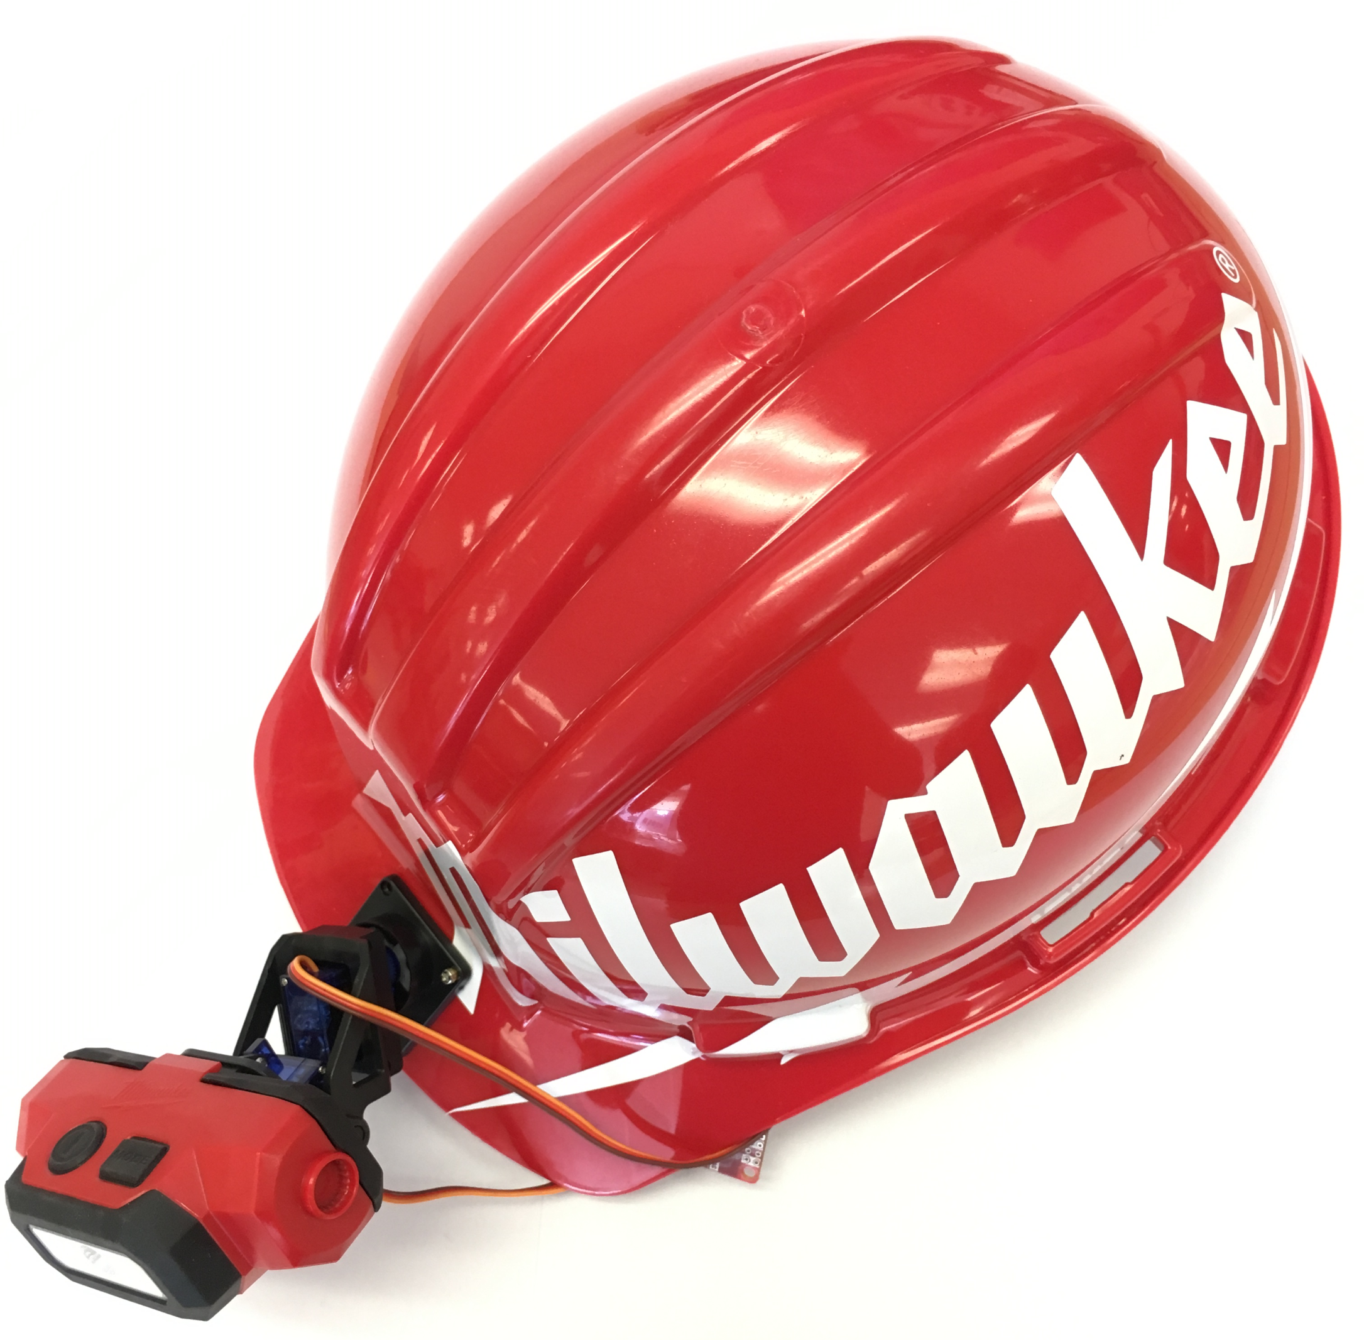
Milwaukee Tool Tracking Headlamp

Slide 2
Outline
Problem Statement – Addresses the problem that will be solved in engineering
Solution – The team's approach to solving this problem
Solution Alternatives – Weighing design decisions against alternative methods to solve the same problem
Test Result Summary- Compliance test result
Feras

Slide 3
Outline
Preliminary Project Specifications – Design requirement specifications made by the customer
Block Diagram – Block diagram of the subsystems and how they interface with each other
Major Subsystems and Specification – The modules chosen to meet design specifications
Integration – what was integrated
Abdullah

Slide 4
Outline
Price/Cost Analysis – Considerations made in terms of all subsystems design prices
EE 408 Subsystem Test Plan and Results – Summarized outcomes of IMU and Magnetometer test plan and results
Shortcomings and Strengths – What were our best takeaways and what needed improvement
Problems and Risks – Problems we have faced, challenges with integrating subsystems, and risks with development
Matt

Slide 5
Workers and hobbyists need headlamps to adapt to their work environment and Milwaukee Tool wants to offer tracking and extra features to their existing designs.

Slide 6
Solution Should satisfy
Functional requirement
Material cost expectations
Deadlines
Accuracy
Efficiency of Power

Slide 7
Solution: A development board was chosen
Inertial Measurement Unit (IMU) – pitch & yaw
Magnetometer - yaw
Servomotors
Thermistor
Photocell
Power System (USB) Port

Slide 8
Solution Alternatives
Some solutions available that can do the same job
Had to pick based on design requirements from Milwaukee Tool
Solution chosen based on team's evaluation of project timeline and design constraints

Slide 9
Solution Alternatives
For the tracking subsystem:
1. Camera feedback with microcontroller
2. IMU & Magnetometer with microcontroller
For the servomotors:
1. Servo 1 with plastic gears
2. Servo 2 with carbon fiber gears

Slide 10
Solution Alternatives
Attributes of Tracking | Camera | IMU & Magnetometer | Attributes of Servomotors | Plastic Gear | Fiber Gear
Material Cost | ~ $ 90.99 | ~ $ 24.98 | Material Cost | ~ $ 6.29 | ~ $ 5.95
Design Cost in Term of Time | Low | High | Design Cost in Term of Time | Equal to option 2 | Equal to option 1
Power Consumption | ~ 1.105 W | ~ 0.0271 W | Power Consumption | ~ 0.20 W | ~ 1.70 W
Possibility | Available | Available | Possibility | Available | Available
Accuracy Test [Within 5%] | Pass | Pass | Accuracy Test [Within 5%] | Pass | Pass
Satisfies Functional Requirements | Yes | Yes | Satisfies Functional Requirements | Yes | Yes

Slide 11
IMU choices
3 axis accelerometer vs 6 axis IMU
6 axis IMU has a Gyroscope which will provide more precise results
Gyroscope has quicker readings
Simplifies the program

Slide 12
Tests performed summary
1A) Verify that the device is compatible with a Milwaukee Red LithiumTM Battery Pack, which supplies 3.6V when fully charged. This test will also find the minimum voltage that the circuit still operates (Passed)
1B) Verify that the headlamp will cast a light for at least one-hundred twenty minutes while being powered by an initially fully charged (Spec) battery, which needs further analysis.
1C) Check if the pushbuttons and switches work, which needs further design.
1D) Verify that the LEDs brightness can be controlled by sending a PWM signal based on the lux reading from the ambient light detector (Passed)

Slide 13
Tests performed summary
2A) Verify that the device will have the ability to direct the light about two axes over a range of 100 degrees in both directions to maintain the illumination of the LED at a fixed direction when tracking is enabled, which needs further design.
2B) Check if the device’s tracking feature will only be available with the White LED mode (Passed)

Slide 14
Tests performed summary
3A) Verify that when tracking enabled, after no motion is detected for more than 5 minutes, the device enters a low power state, needs further design.
3B) Verify that the total combined leakage current from the battery to the device is less than 1mA when the device is in the low power state, need further design.
4A) Check the mass of the device, which should be less than 300 grams excluding the battery. Also, to check if it is hardhat attachable (Passed)

Slide 15
Milwaukee Tool Specifications
Powered by a Milwaukee Red Lithium™ Battery Pack
The Headlamp should cast light for120 minutes fully charged
User select auto-brightness
Auto shutdown when overheating
Choose between White and Red (stationary) LEDs
Notes:
i. This requires the device to run with a power supply ranging between 3 and 4V
The output brightness will automatically adjust based on ambient light levels

Slide 16
MILWAUKEE TOOL SPECIFICATIONS
Low state power after 5 minutes of inactivity when the tracking is enabled
Total combined leakage current from the battery to device <1mA in low state power
<300 grams without battery
<20$ bill of materials for tracking feature

Slide 17
MILWAUKEE TOOL Tracking SPECIFICATIONS
Tracking feature enable/disable button
Direct light 100◦ range about two axes
Maintain illumination of a fixed direction
Only white LED can be used with tracking

Slide 18
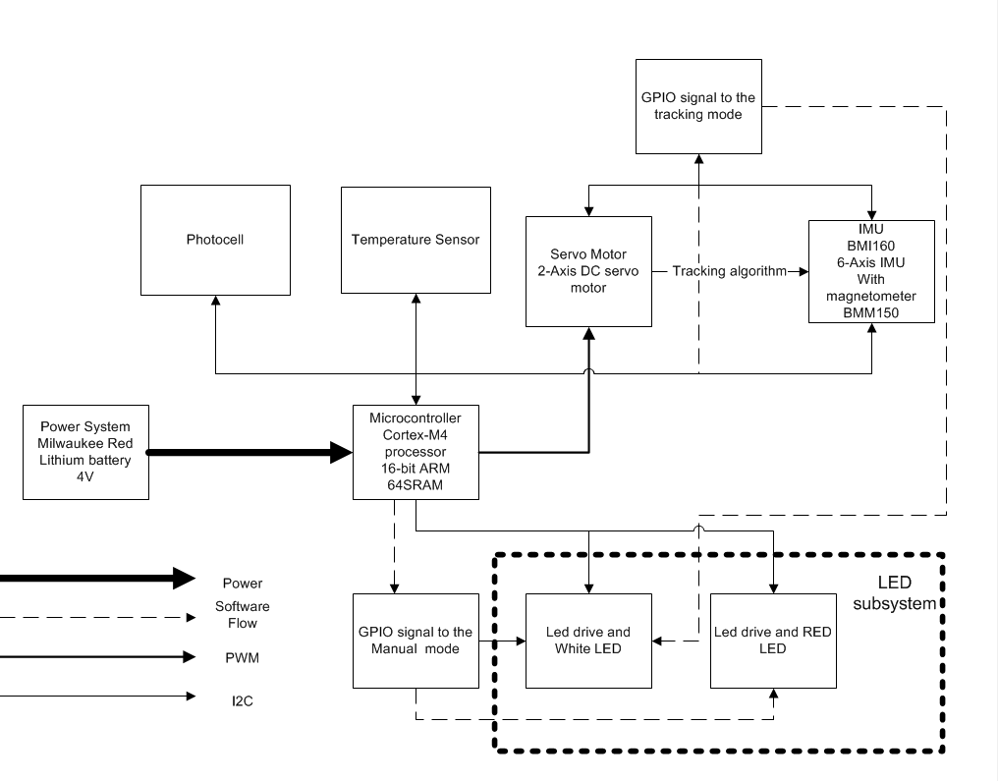
system diagram

Slide 19
Power subsystem
Milwaukee Red Lithium™ Battery Packs
Required by Milwaukee Tool
Specifications
Ranging between 3V and 4V
Capacity2.0Ah; 10 Wh
Notes:
Luckly of us these battery were already tested.

Slide 20
Microprocessor
Texas Instruments MSP432P401R pack (Development board) was used
Specifications
16 bit ARM processor
Faster and used FPU
SupplyVoltageRange:1.62V to 3.7 V
I2C (with multiple-slave addressing)
Ultra-Low-Power Operating Mode
Notes:
16 bit

Slide 21
Inertial measurement unit (IMU) with Magnetometer
Critical component to the tracking feature
Provide position and motion changes
Covers x, y and z axes when tracking is enabled

Slide 22
Specifications
6 axis IMU with Magnetometer
Supply Voltage - 1.2 - 3.6 VDC
Digital interfaces I2C
Gyroscope Sensitivity: The subsystem uses 125°/s
Magnetometer Resolution: 0.3μT, which makes this subsystem very accurate

Slide 23
Servo motor
Servo motors are going to use data from IMU
Servos will move the white LED to a fix point
2 servos are used
Vertical
Horizontal

Slide 24
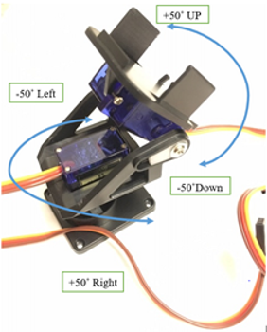
How do the servos move?

Slide 25
Specifications
Operating speed: 0.1 s/60 degree
Operating voltage: 3.2V minimum
Needs boost converter if motion desired when battery <3.2V
PWM interface
Weight: 3.9 g

Slide 26
Temperature Sensor
When the temperature is high, the system should shutdown
Specifications
Operating Voltage 2.5 to 5V
Digital interface: I2C

Slide 27
photocell sensor
Auto-brightness: The output brightness automatically adjusts based on ambient light levels
Specifications
Operating Voltage, V_{S} = 1.6 to 3.6V
Measurements: 0.01 lux to 83 k lux
Low Operating Current: 1.8 µA

Slide 28
Red and white leds
Previous design from Milwaukee Tool chosen for the LED and LED drives
Specifications
Switchable between Red and White LEDs
Red LED for manual mode
White LED for tracking mode
Red LED is stationary

Slide 29
integration
Designed finite state machine for tracking algorithm motor controls
Programed to control LED brightness with photocell
Programed pushbuttons to enable to the tracking feature
Mounted the device on a helmet
Ran the system through compliance testing

Slide 30
price Analysis
New bill of materials will be less expensive
Estimated bulk prices (when ordered part by part in amounts of 5000)
1. Bosch BMI160 IMU- $2.08 per unit
2. OPT3001 light sensor- $1.43 per unit
3. TMP007 temperature sensor- $1.78 per unit
4. Tower Pro SG-92R DC servomotor – $2.25 per unit
5. MSP432 Microcontroller - $4.05 per unit
(Total: $11.59 for these parts)

Slide 31
Cost analysis
Needs more time in development
Prototype shows what approaches have failed
Still uses dev board – no PCB design yet
Could be offered as a senior design project in 2019
Servomotors have moving parts
LED dome idea had no gears
May be more costly implementing dome

Slide 32
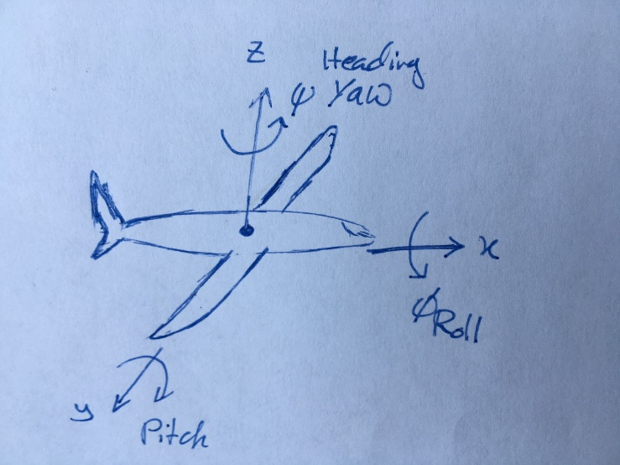
RESULTS
Defining angles of rotation about axes
Pitch (Theta) – Rotation about y-axis
Roll (Phi) – Rotation about x-axis
Yaw (Psi) – Rotation about z-axis

Slide 33
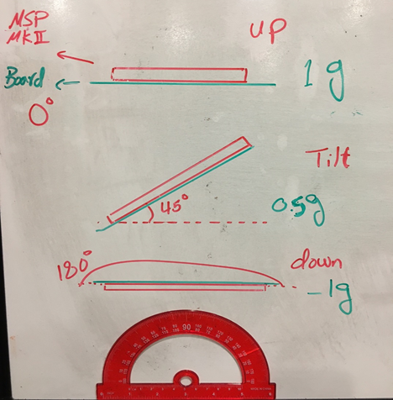
TEST PLAN AND RESULTS
Basic Diagram of Accelerometer Pitch Test Setup

Slide 34
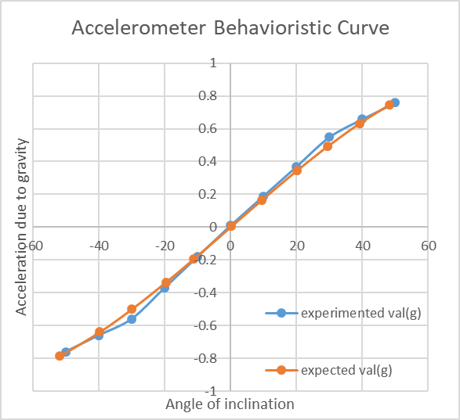
RESULTS
Output Acceleration in g's vs Pitch Angle in Degrees

Slide 35
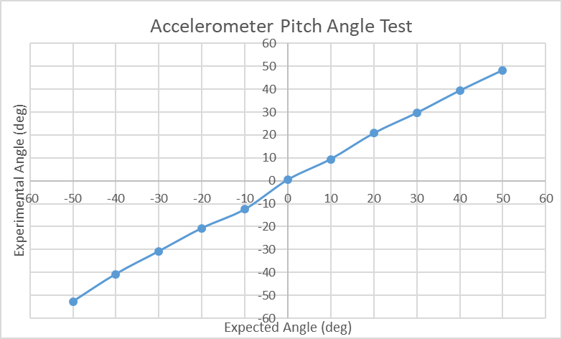
RESULTS
Accelerometer Pitch Test table and results
Expected Angle, rotation about y-axis Theta (deg) | Experimental Angle rotation about y-axis, Theta (deg) | Experimental Angle rotation about z-axis, Psi (deg)
50 | 48.28 | 0.66
40 | 39.38 | 0.76
30 | 29.64 | 0.85
20 | 20.75 | 0.94
10 | 9.45 | 0.97
0 | 0.43 | 0.99
-10 | -12.49 | -0.97
-20 | -20.73 | -0.93
-30 | -30.82 | -0.85
-40 | -40.76 | -0.77
-50 | -52.8 | -0.66

Slide 36
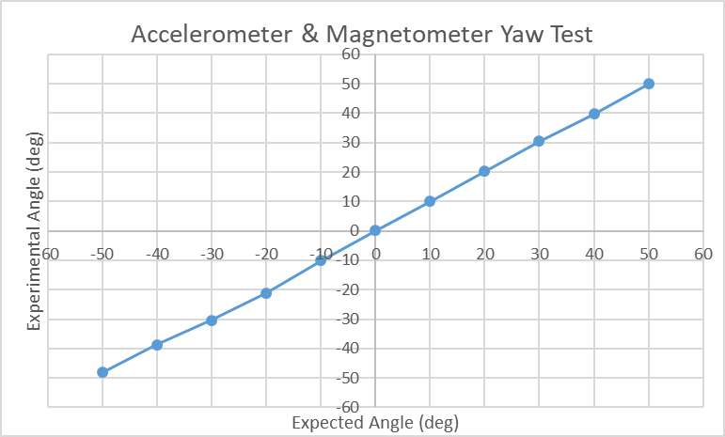
RESULTS
Accelerometer and Magnetometer Yaw Test table and results
Expected Angle, Rotation about z-axis Psi (deg) | Experimented Angle Rotation about z-axis, Psi (deg) | Experimented Angle Rotation about y-axis, Theta (deg)
50 | 49.898 | 0.32
40 | 39.635 | 0.32
30 | 30.378 | 0.33
20 | 20.162 | 0.23
10 | 9.947 | 0.26
0 | 0.141 | 0.23
-10 | -10.169 | 0.32
-20 | -21.213 | 0.32
-30 | -30.333 | 0.34
-40 | -38.667 | 0.33
-50 | -48.201 | 0.31

Slide 37
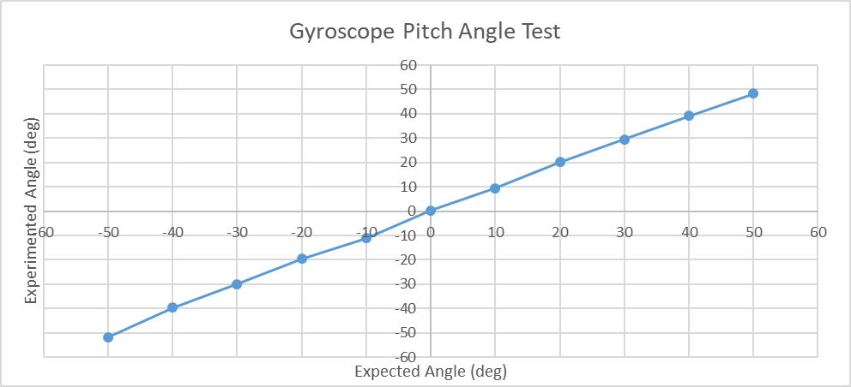
RESULTS
Combinatorial Pitch Test table and results
Expected Angle, Rotation about y-axis Theta (deg) | Experimented Angle Rotation about y-axis, Theta (deg) | Experimented Angle Rotation about z-axis, Psi (deg)
50 | 48.31 | 74.06
40 | 39.25 | 73.08
30 | 29.56 | 74.26
20 | 20.2 | 73.95
10 | 9.46 | 74.02
0 | 0.33 | 74.02
-10 | -11.2 | 74.35
-20 | -19.61 | 73.98
-30 | -30.03 | 74.10
-40 | -39.64 | 74.12
-50 | -51.78 | 74.16

Slide 38
RESULTS
Pitch and Yaw values from the combinatorial filter used to move the servomotor and keep the light fixed on the target

Slide 39
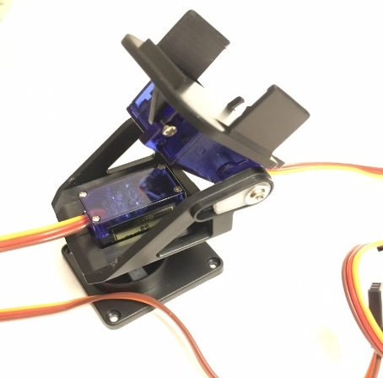
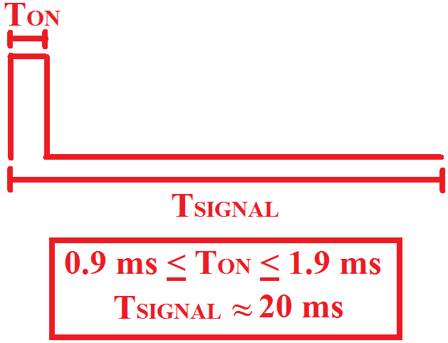
results
Servo motor demonstration
Servo angle (degrees) | Pulse Width (ms) [Predicted] | Pulse Width (ms) [Measured]
-90 | 0.52 | 0.52
-50 | 0.90 | 0.90
-40 | 1.00 | 1.00
-30 | 1.10 | 1.10
-20 | 1.20 | 1.20
-10 | 1.30 | 1.30
0 | 1.40 | 1.40
+10 | 1.50 | 1.50
+20 | 1.60 | 1.60
+30 | 1.70 | 1.70
+40 | 1.80 | 1.80
+50 | 1.90 | 1.90
+90 | 2.30 | 2.30

Slide 40
Shortcomings
Implementing the auto-shutdown after 5 minutes of no motion
High temperature shutdown function
Power system integration
Headlamp is heavy, yielding slow response from motors
Yaw compensation
Prone to electromagnetic interference
Recommend using another approach
Dr. Kelnhofer suggests a different magnetometer

Slide 41
Strengths
Dependable pitch compensation
I/O and settings ready for auto-brightness
Motors work as low as 3.2V without boost converter
Devices can be configured to low-power modes
Another prototype could negate most shortcomings
Power consumption can be evaluated without integrating power system
Best case scenario: 0.66W
Worst case scenario: 1.37W

Slide 42

Problems and risks
Lithium batteries raise concern for fire hazards
Safety features built in by Milwaukee Tool's battery management circuit
Must not suffer from structural damage causing the lithium ions to leak
Milwaukee Tool’s hard plastic case protects the battery

Slide 43
Problems and risks
Tracking algorithm needs better yaw design
Do not give the MSP432 too much voltage
Need to anticipate test failures
Programs and subsystems may need to be redesigned
Gimbal lock
Euler angles used - try quaternions

Slide 44
Questions and answers

